Slide 1


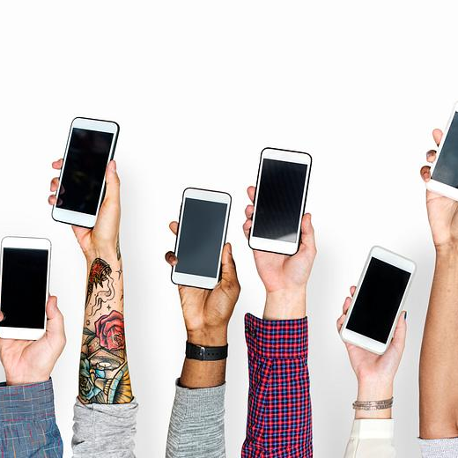
DATA ANALYSIS INTERNSHIP PROJECT
Team HOGWARTS Team lead : SHAIK ZEBA ALMAS, 20149
SRAVANAM VENNELA, 20143
HUSNA AKHEEL, 20159
Supervisor Name : A Zaheer Sha
Trainers Name: A Jayanth, SHAIK Rafeeq Ahamed

Slide 2
About the Internship
INTERNCALL
Duration: 2 Months
Role: Data Analyst Intern
Tools Used: Pandas and Matplotlib

Slide 3
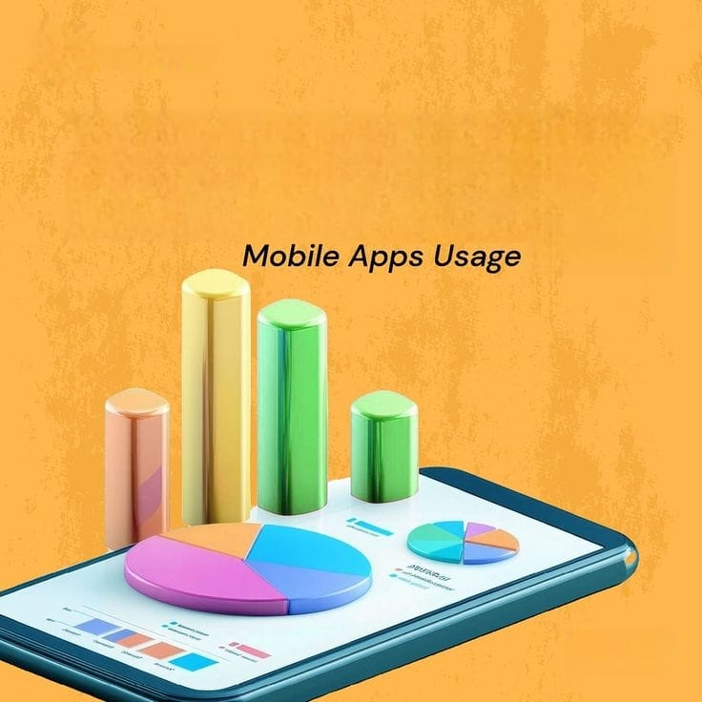
Problem Statement
Analyzing Daily Mobile Usage Patterns

Slide 4
Dataset Information
User_ID | Date | Day | Screen Time Hours | App Usage Hours | Data Consumption MB | Calls Minutes | Messages Count | Battery Usage Percent
U1001 | 01-02-2026 | Sunday | 4.5 | 3.3 | 1695 | 61 | 166 | 33
U1002 | 02-02-2026 | Monday | 4.7 | 3.1 | 2825 | 51 | 106 | 58
U1003 | 03-02-2026 | Tuesday | 7.1 | 4.5 | 2482 | 118 | 81 | 61
U1004 | 04-02-2026 | Wednesday | 7.6 | 1.5 | 2331 | 13 | 122 | 78
U1005 | 05-02-2026 | Thursday | 6.8 | 3 | 2592 | 116 | 160 | 56
U1006 | 06-02-2026 | Friday | 6.4 | 4.3 | 2332 | 46 | 116 | 48
U1007 | 07-02-2026 | Saturday | 2 | 4.4 | 1120 | 10 | 162 | 58
U1008 | 08-02-2026 | Sunday | 6.8 | 2.6 | 1590 | 28 | 88 | 80
U1009 | 09-02-2026 | Monday | 2.7 | 2.7 | 2043 | 40 | 31 | 60
U1010 | 10-02-2026 | Tuesday | 6 | 4.2 | 783 | 63 | 95 | 46

Slide 5
Tools & Technologies Used
Python
Pandas
Matplotlib
CSV Dataset
Google Colab

Slide 6
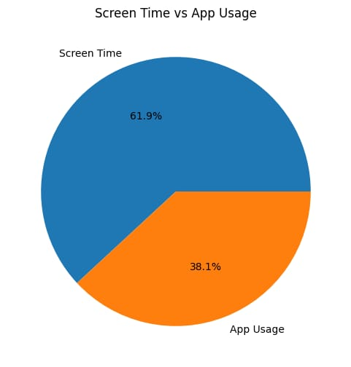
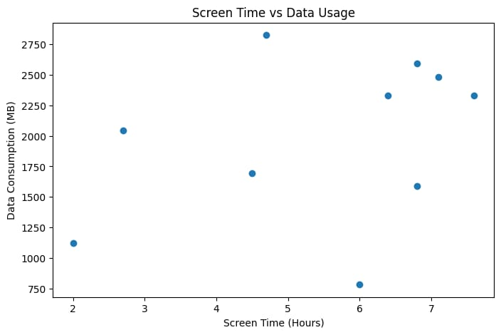
Code
plt.figure(figsize=(6,6))
plt.pie([total_screen, total_app],
labels=["Screen Time", "App Usage"], autopct="%1.1f%%")
plt.title("Screen Time vs App Usage")plt.show()
plt.figure(figsize=(8,5))plt.scatter(
df["Screen Time Hours"],
df["Data Consumption MB"])plt.title("Screen Time vs Data Usage")
plt.xlabel("Screen Time (Hours)")
plt.ylabel("Data Consumption (MB)")plt.show()

Slide 7
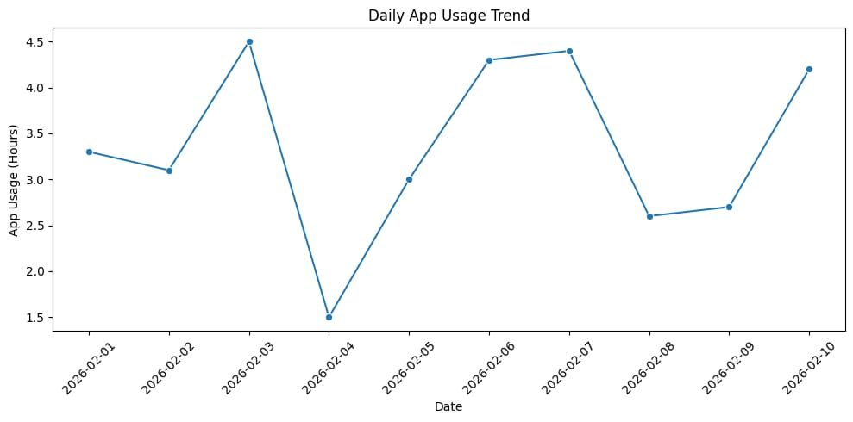
Code
plt.figure(figsize=(10,5))sns.lineplot(x="Date", y="App Usage Hours", data=df, marker="o")
plt.title("Daily App Usage Trend")
plt.xlabel("Date")plt.ylabel("App Usage (Hours)")
plt.xticks(rotation=45)plt.tight_layout()plt.show()

Slide 8
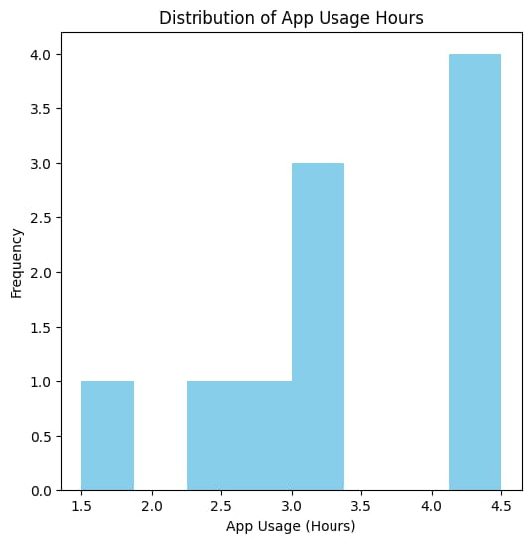
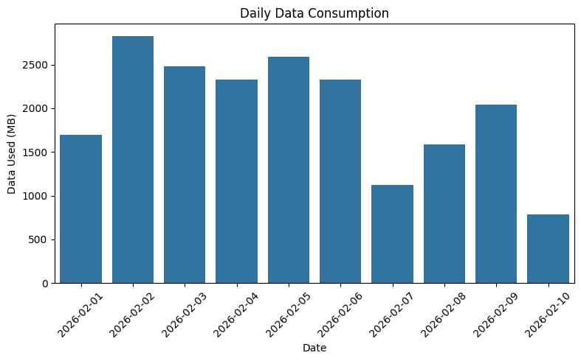
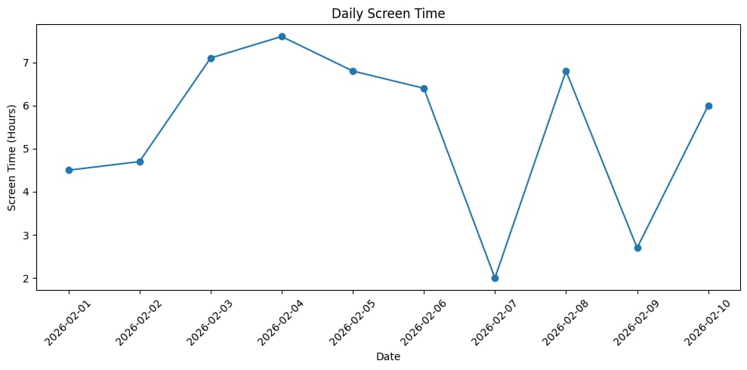
Output

Slide 9
Challenges Faced
Handling the date format
Understanding some pandas functions
Creating clear visualizations
Interpreting the analysis results
Working with the dataset

Slide 10
Conclusion
In this project, mobile usage data was analyzed to understand daily screen time, app usage, and internet consumption. Using Python with pandas and matplotlib, important values like average usage and the days with highest activity were identified. The graphs helped visualize the patterns clearly and made it easier to understand how mobile usage varies over time.

Slide 11
Future Improvements
Larger and more detailed dataset
Handling missing or inconsistent data
Including app category usage
Weekly and monthly usage trend analysis
More advanced data visualizations

Slide 12

Thank You
Questions?

